Slide 1
Fashion-MNIST Project

Slide 2
Data Source
Fashion-MNIST is a dataset of Zalando's (http://www.zalando.com ) article images —consisting of a training set of 60,000 examples and a test set of 10,000 examples. Each example is a 28x28 gray scale image, associated with a label from 10 classes.
Fashion-MNIST serves as a direct drop-in replacement for the original MNIST dataset for benchmarking machine learning algorithms. It shares the same image size and structure of training and testing splits.
filePath = '/cxldata/datasets/project/fashion-mnist/’

Slide 3
Objective
The objective of the project is to use Fashion-MNIST data set to identify the different fashion products from the given pictures using various best possible models (ML algorithms) and report the values of the performance measures for different models.
Also, report the model that performs best, and fine-tune the same model using one of the model fine-tuning techniques, and report the best possible combination of hyper parameters for the selected model. Lastly, use the selected model to make final predictions and report the values of various performance measures for the same.

Slide 4
Steps in creating the model
Importing Libraries
Defining Functions
Loading the data
Understanding the data
Data Preparation
Training the Model:
SGDClassifier, Softmax Regression, DecisionTreeClassifier, RandomForestClassifier, VotingClassifier
Cross Validation
Selecting the Model:
SGDClassifier, Softmax Regression, DecisionTreeClassifier, RandomForestClassifier, Voting Classifier
Fine-Tuning the Model - Grid Search - Dimensionality Reduction , Tuning Hyperparameters
Evaluating Final Model on Test Dataset

Slide 5
Findings after training and testing the various models
Name of Model | Accuracy | Precision | Recall | F1 Score
SGD Classifier | 0.8489 | 0.849 | 0.8489 | 0.848
Softmax Regression | 0.87755 | 0.876 | 0.87755 | 0.876
Decision Tree | 1.0 | 1.0 | 1.0 | 1.0
Random Forest | 1.0 | 1.0 | 1.0 | 1.0
Voting Classifier | 0.9653 | 0.965 | 0.9653 | 0.965
Decision Tree and Random Forest Classifier have a value of 1.0 in each property because they have a tendency to overfit the data

Slide 6
Selecting the Model - Cross-Validation
We use cross validation to find the proper score of each model, also to ensure that the model is not overfitting or underfitting. Based on this cross-validation, we select the model for fine-tuning its hyperparameters.
If the cross validation score values for a performance measure (say accuracy) are not varying significantly for various folds (k-folds), then we can say that the model is not overfitting.
If the cross validation score values for a performance measure (say accuracy) are not very low for various folds (k-folds), then we can say that the model is not underfitting.

Slide 7
Cross Validation Scores of Various Models
Name of Model | Accuracy | Precision | Recall | F1 Score
SGD Classifier | 0.835 | 0.835 | 0.835 | 0.835
Softmax Regression | 0.8470 | 0.8458 | 0.8470 | 0.846
Decision Tree | 0.789 | 0.789 | 0.789 | 0.789
Random Forest | 0.848 | 0.848 | 0.848 | 0.845
Voting Classifier | 0.863 | 0.861 | 0.863 | 0.861
Since Voting Classifier's results are the best in cross-validation phase, we select Voting Classifier model as our model to proceed with the fine-tuning of the model (hyperparameters tuning).

Slide 8
Fine-Tuning the Model
We performed fine-tuning of this XGBoost model using 'Grid Search' technique.
Grid search takes a lot of time on large datasets. Hence, we applied 'Dimensionality Reduction' to the training dataset to reduce the number of features in the dataset, so that the time taken for grid search and prediction is reduced.
Also, we calculated the scores based on the reduced features.

Slide 9
Fine-Tuning the Model - Grid Search - Dimensionality Reduction
We will be using Projection technique (PCA) for dimensionality reduction for our problem.
We will use Scikit Learn's PCA class which uses SVD (Singular Value Decomposition) internally and also the projection.
For the current problem, with n_components=0.95, in the reduced dataset (X_train_reduced) we got only 187 features (out of original 784), and there was significant loss of information (quality) in the 'recovered' (decompressed) images. Hence, we have selected n_components=0.99, which gives 459 features (out of original 784) and there is no significant loss of information (quality) in the 'recovered' images.
The comparison of the 'original' dataset images and the 'compressed' dataset images (got after decompression) shows that there is not much information loss due to dimensionality reduction by using 0.99 variance ratio. Hence, we will go ahead with performing the Grid Search using this 'reduced' training dataset (X_train_reduced).

Slide 10
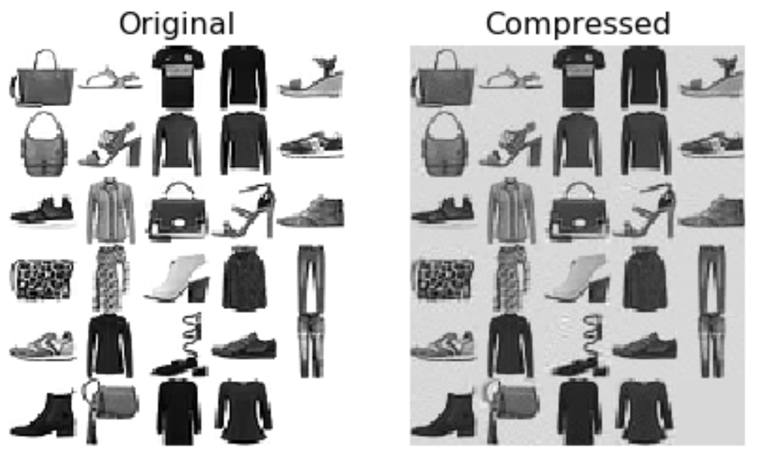
Result

Slide 11
Fine-Tuning the Model - Grid Search - Tuning Hyperparameters
Let us now perform the Grid Search using the dimensionally reduced training dataset X_train_reduced.
Since our best model is Voting Classifier which is made up of two models Logistic Regression and Random Forrest. To do the grid search, we will have to supply the various values of parameters for both of the underlying models.
Since the grid search is a very intensive process, we are going to only try a handful of permutations because it would take a huge time otherwise.

Slide 12
Evaluating Final Model on Test Dataset
Since, we already got our 'final' model from grid search (best_estimator_), let us evaluate the same on the test dataset.
Final Accuracy: 0.8477
Final Precision: 0.8455
Final Recall: 0.8477
Final F1 Score: 0.8460

Slide 13
Conclusion
We started off with a clean slate, taking the data set in hand and making it useful for training. We had many training models at our disposal so we tried out multiple models on our dataset and obtained the results of each. After comparing we found that the Ensemble(Voting Classifier) was the most superior of all of the other techniques and hence we selected that model for our Fashion MNIST model.
We also took the cross validation of each model and came to know that the Decision Tree Classifier and the Random Forest Classifiers tend to overfit the data and hence not suitable for our model training purpose.
After training and selecting the optimum model , we went a step further in fine tuning the hyper parameters to obtain even better score on the testing parameters such as Accuracy. Finally after all the steps we obtained the final model ready to be tested on a test data.
The final score results were really encouraging , which could even further be improved by a little tweaking of the hyper parameters.

Slide 14
Thanks
Prepared by : Mr. Sridhar C Iyer
srdhr1234@gmail.com / c.sridhar89@gmail.com
Asst. Professor
7028675620 / 8806820260

